Slide 1
Motion Detection via Communication Signals
Presenters
Signals and Systems Laboratory Project 2
Wan Peng
12011615
Wang Zhuoyang
12112907
Liu Qianyi
12011812
Feng Yanjie
12010825
June 2, 2022

Slide 2
Introduction
Background Information
Multipath Propagation
Doppler Shifting
Radar
Objective
Methodology
Motion Analysis
Ambiguity Function

Slide 3

Wp

Slide 4
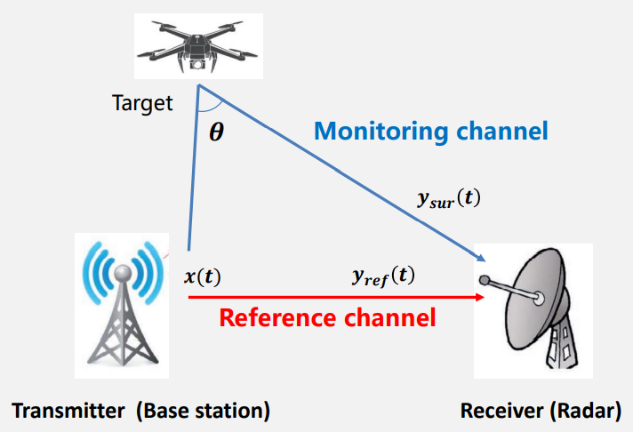
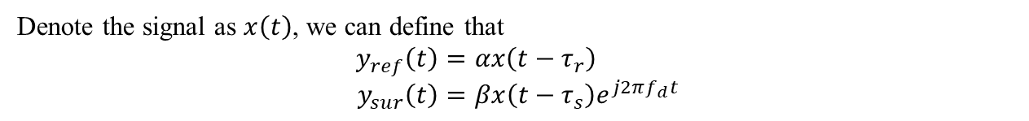
Introduction Background Information Multipath Propagation
Signals reaching the receiving antenna by two or more paths. Because of the existence of buildings and the mountain, signals may be reflected, thus the multipath propagation formed.
Multipath propagation led to attenuation and limit the broadband and transmitting speed. The signal received by the receiver is the superposition of the direct wave and many reflected waves.
Figure 1: A Simple Model for Multipath Propagation
Denote the signal as $x\left(t\right)$, we can define that
$$\begin{aligned}y_{ref}\left(t\right)=αx\left(t−τ_{r}\right)\#\#\end{aligned} \\ \begin{aligned}y_{sur}\left(t\right)=βx\left(t−τ_{s}\right)e^{j2πf_{d}t}\#\end{aligned}$$

Slide 5
Introduction Background Information Doppler Frequency
When the source and observer of a signal are moving relatively, the frequency will change. Increase when approaching (which is called a “blue shift”), decreasing when move apart (which is called a “red shift”).
The wave source will send out a wave after vibration, and the receiver will receive different frequency due to relative movement.
$$f^{′}=\left(\frac{v±v_{0}}{v∓v_{s}}\right)f$$

Slide 6
Introduction Background Information Radars
The device which can analyze high frequency radio waves reflected from surfaces of objects to determining their position and velocity.
There are active radars: Both transmitter and receiver are radar. Transmitter and receiver located nearly. And Passive radars: Base station serve as transmitter and radar is the receiver. Receive a reference signal from a transmitter through a direct path. Then receive a scattered signal from the target. Calculating the time difference and frequency difference between the samples of the two signals.

Slide 7
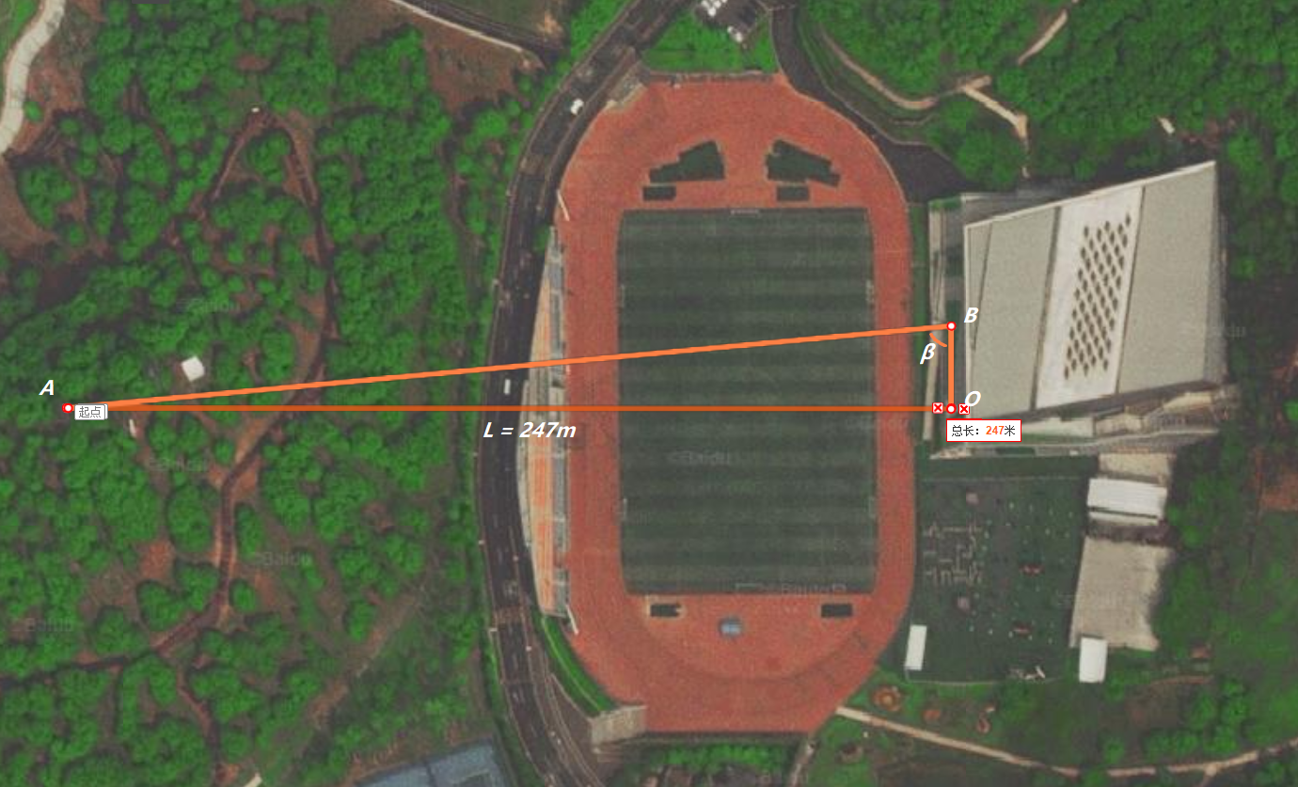
Introduction Objective
The objective of this project is that we have a runner (point B) on the platform of the Run Yang Gymnasium, running back and forward. There is a working base station (point A) perpendicular to the running route directly opposite. We set up two antennas at the foot of perpendicular (point O). These are all illustrated in Figure 2.
Now we want to know how the runner’s motion is like, only according to the signals we received.
Figure 2: The Top View of the Site
Wzy

Slide 8
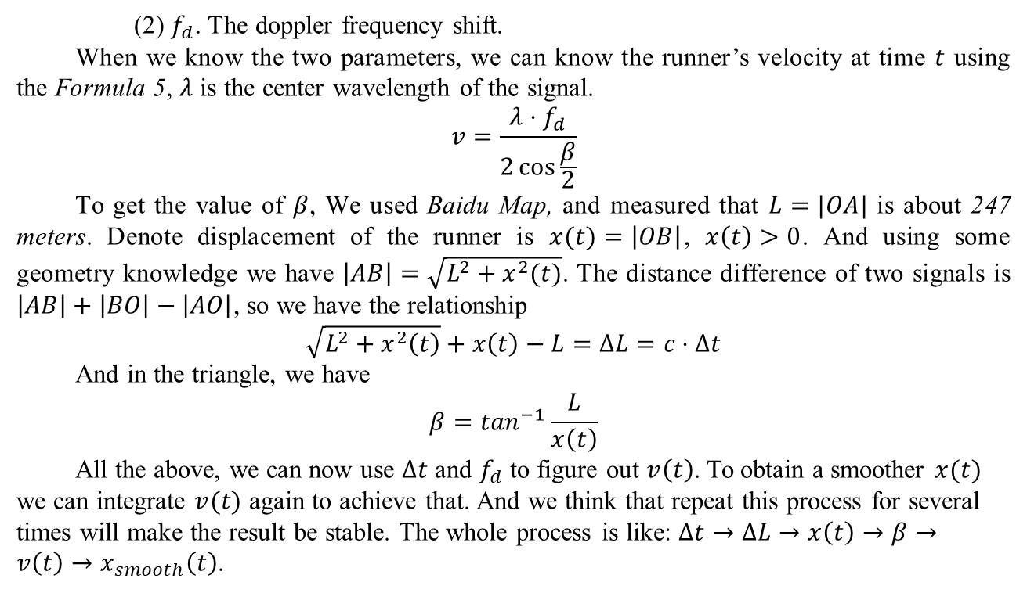
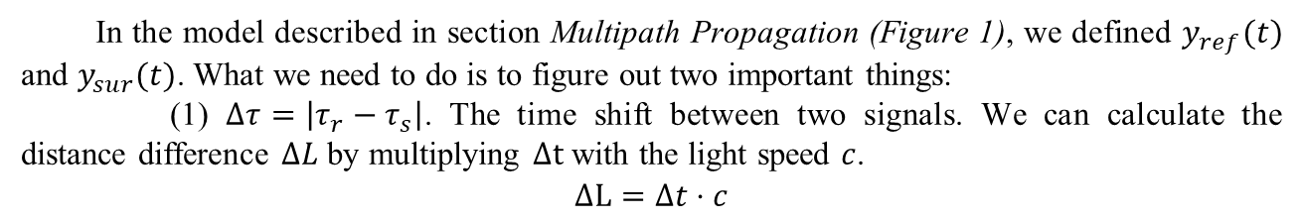
Introduction Methodology Motion Analysis
In the model described in section Multipath Propagation (Figure 1), we defined $y_{ref}(t)$ and $y_{sur}(t)$. What we need to do is to figure out two important things:
(1) $Δτ=\left|τ_{r}−τ_{s}\right|$. The time shift between two signals. We can calculate the distance difference $ΔL$ by multiplying $Δt$ with the light speed $c$.
$$\begin{aligned}ΔL=Δt⋅c\end{aligned}$$
(2) $f_{d}$. The doppler frequency shift.
When we know the two parameters, we can know the runner’s velocity at time $t$ using the Formula 5, $λ$ is the center wavelength of the signal.
$$\begin{aligned}\#\end{aligned}v=\frac{λ⋅f_{d}}{2\cos{\frac{β}{2}}}$$
To get the value of $β$, We used Baidu Map, and measured that $L=|OA|$ is about 247 meters. Denote displacement of the runner is $x(t)=\left|OB\right|$, $x\left(t\right)>0$. And using some geometry knowledge we have $\left|AB\right|=\sqrt{L^{2}+x^{2}(t)}$. The distance difference of two signals is $\left|AB\right|+\left|BO\right|−\left|AO\right|$, so we have the relationship
$$\begin{aligned}\sqrt{L^{2}+x^{2}\left(t\right)}+x\left(t\right)−L=ΔL=c⋅Δt\#\end{aligned}$$
And in the triangle, we have
$$\begin{aligned}β=\tan^{−1}{\frac{L}{x\left(t\right)}}\#\end{aligned}$$
All the above, we can now use $Δt$ and $f_{d}$ to figure out $v\left(t\right)$. To obtain a smoother $x(t)$ we can integrate $v(t)$ again to achieve that. And we think that repeat this process for several times will make the result be stable. The whole process is like: $Δt→ΔL→x\left(t\right)→β→v\left(t\right)→x_{smooth}\left(t\right)$.

Slide 9
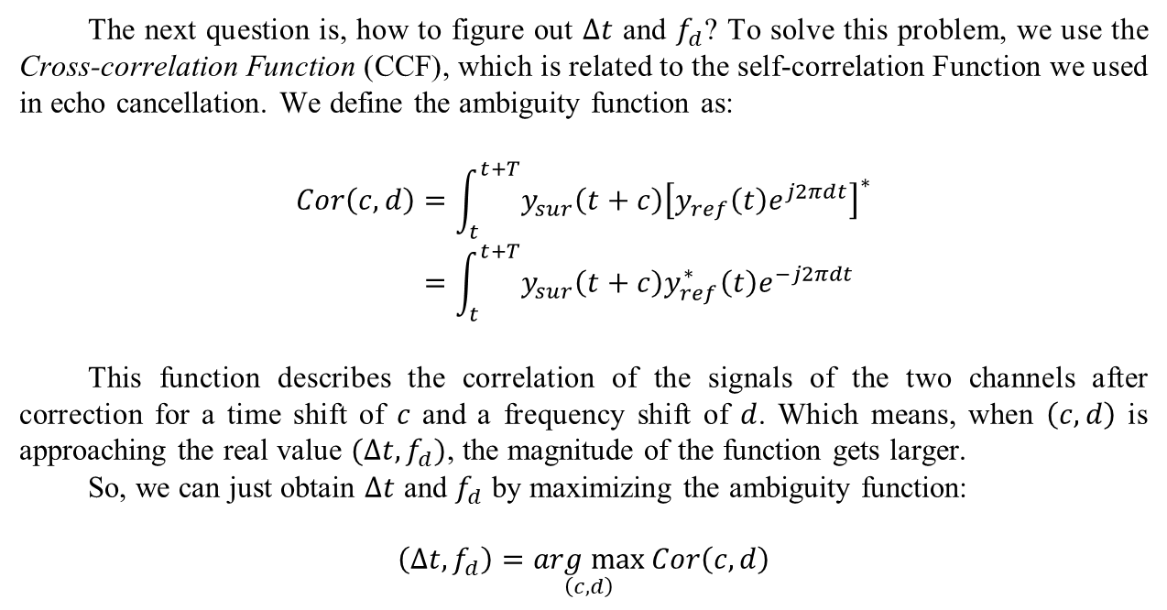
Introduction Methodology Ambiguity Function
The next question is, how to figure out $Δt$ and $f_{d}$? To solve this problem, we use the Cross-correlation Function (CCF), which is related to the self-correlation Function we used in echo cancellation. We define the ambiguity function as:
$$Cor\left(c,d\right)=\int_{t}^{t+T}{y_{sur}\left(t+c\right){\left[y_{ref}\left(t\right)e^{j2πdt}\right]}^{∗}} \\ \begin{aligned}=\int_{t}^{t+T}{y_{sur}\left(t+c\right)y_{ref}^{∗}\left(t\right)e^{−j2πdt}}\#\end{aligned}$$
This function describes the correlation of the signals of the two channels after correction for a time shift of $c$ and a frequency shift of $d$. Which means, when $\left(c,d\right)$ is approaching the real value $(Δt,f_{d})$, the magnitude of the function gets larger.
So, we can just obtain $Δt$ and $f_{d}$ by maximizing the ambiguity function:
$$\begin{aligned}\left(Δt,f_{d}\right)=\underset{\left(c,d\right)}{arg max}{Cor\left(c,d\right)}\#\end{aligned}$$

Slide 10
Results & Analysis
Task 1: Plotting the Spectrums
Task 2: Plotting the Heatmaps
Range – Doppler Frequency
Time – Doppler Frequency
Task 3: Calculating Velocity and Displacement

Slide 11
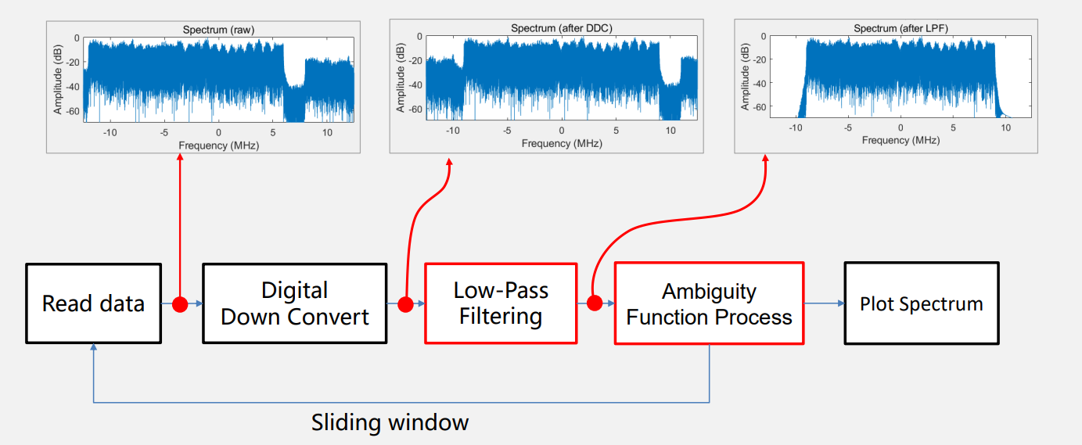
Results & Analysis Task 1
Figure 3: The Simple Model of the Whole System
Step 1: Load Data
Step 2: Digital Down Convert
Step 3: Low Pass Filtering
Fyj

Slide 12
Results & Analysis Task 1
Figure 4: The Frequency Response of the LPF
Fyj

Slide 13
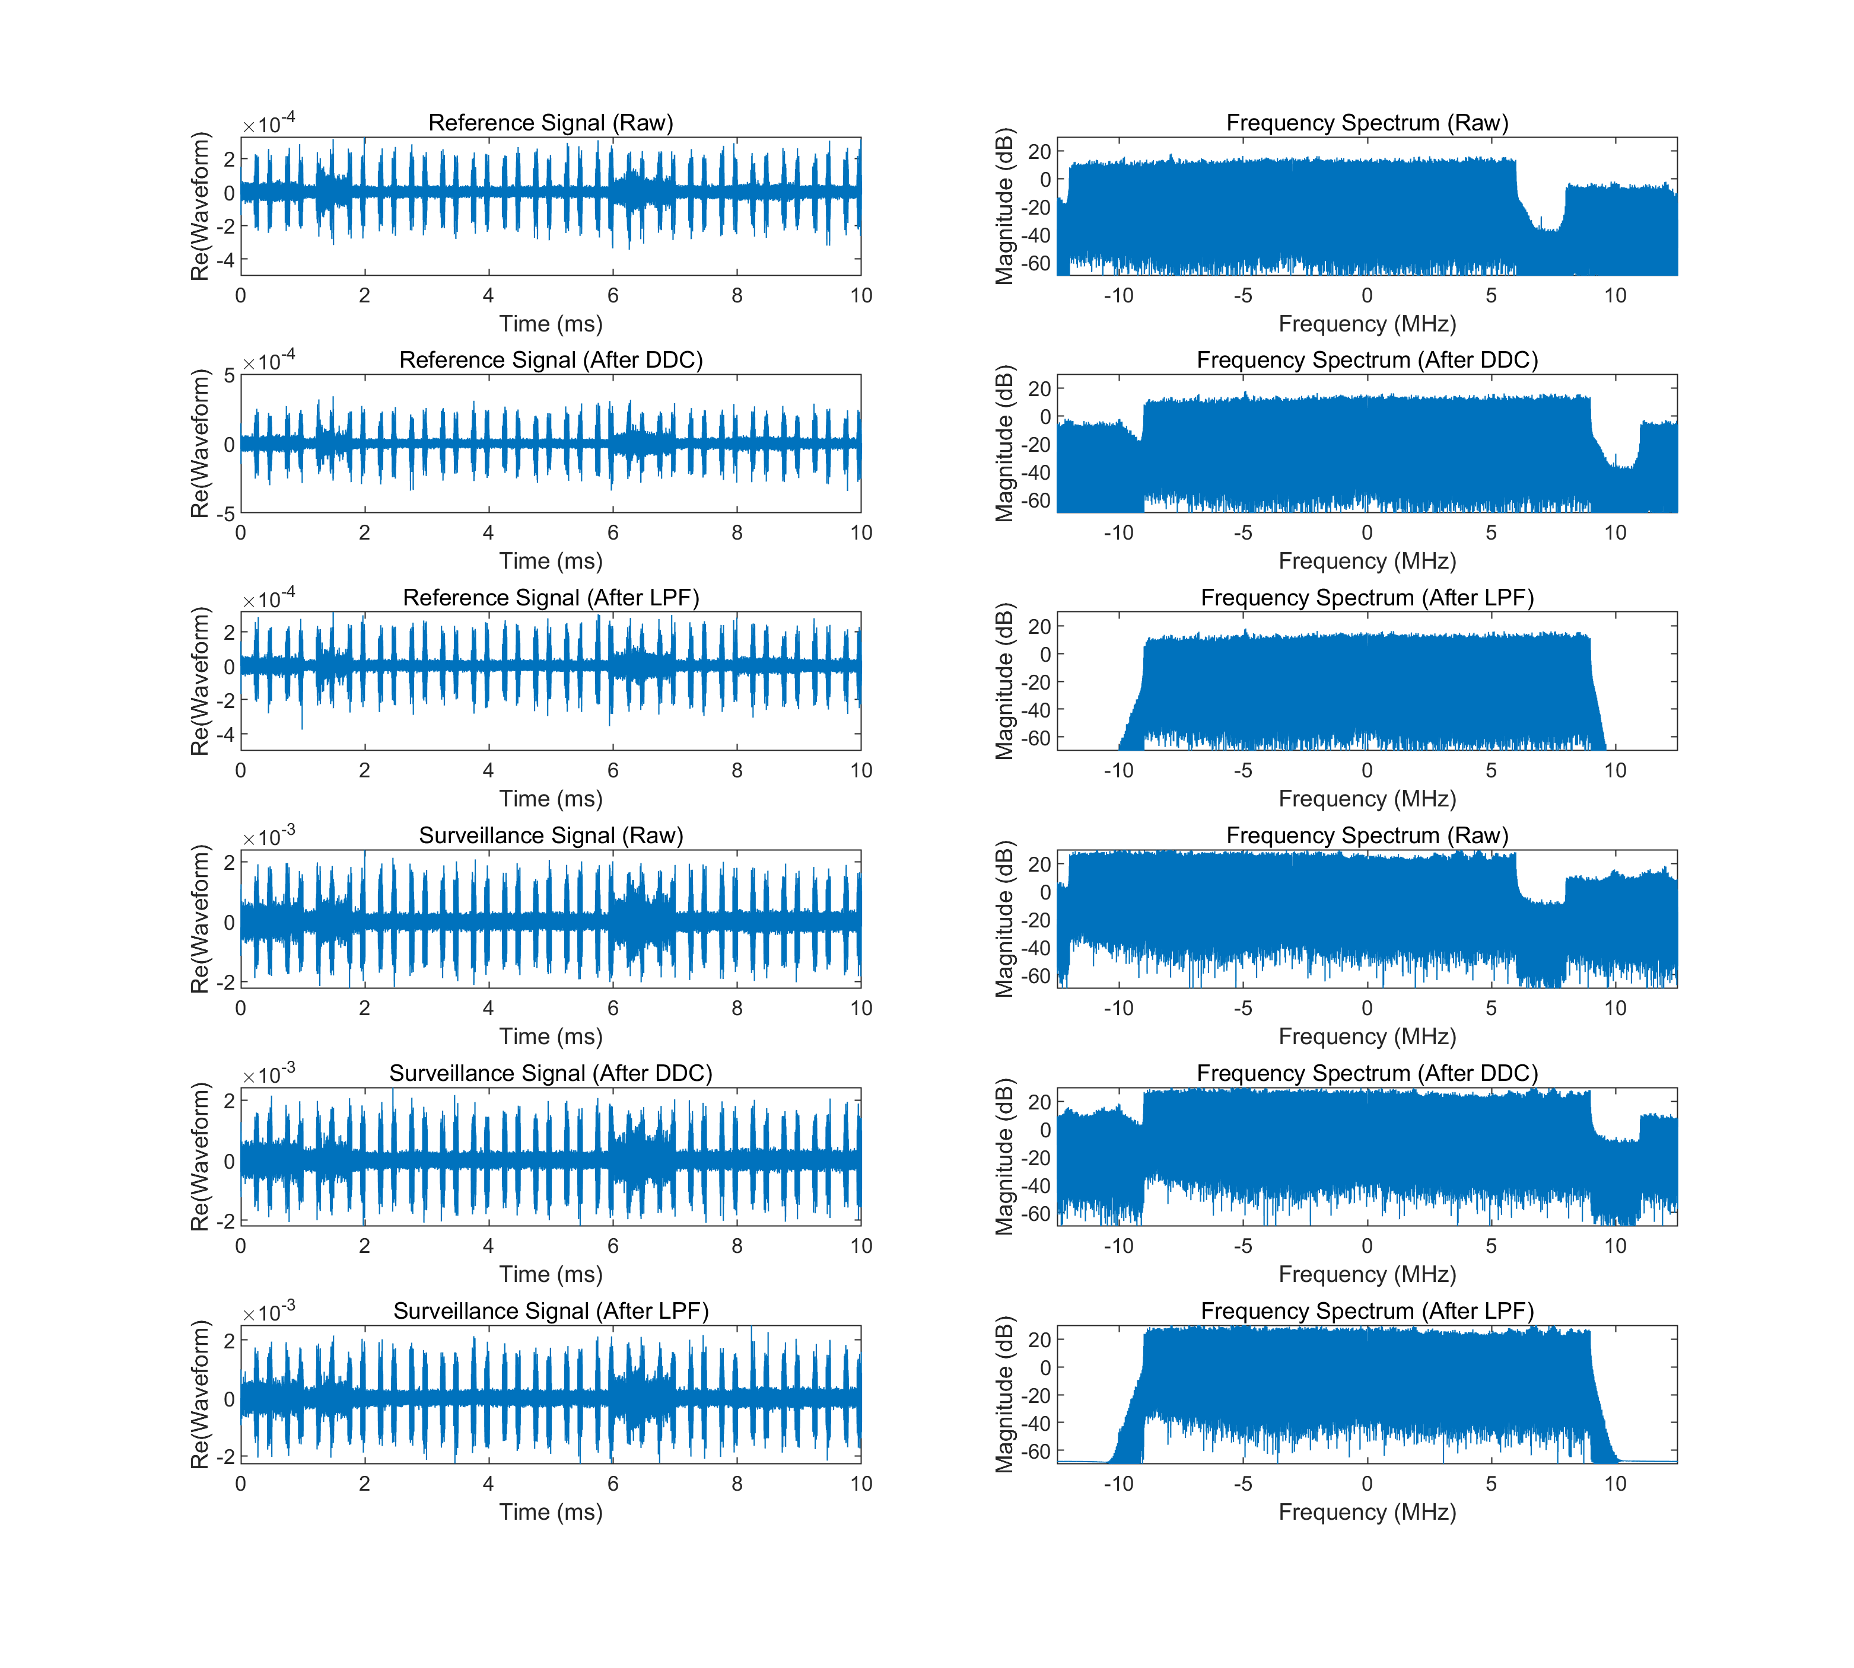
Results & Analysis Task 1
Reference Signal
Surveillance Signal
Figure 5: An Example for the Spectrum (Data 11)

Slide 14
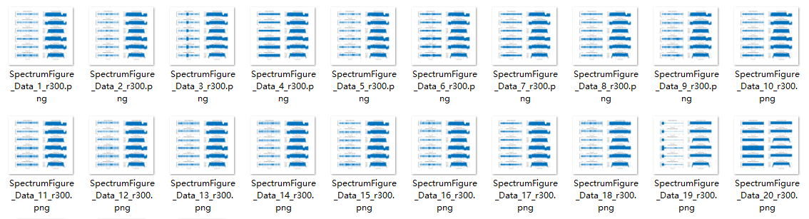
Results & Analysis Task 1
Figure 6: Spectrums for 20 Data Files

Slide 15
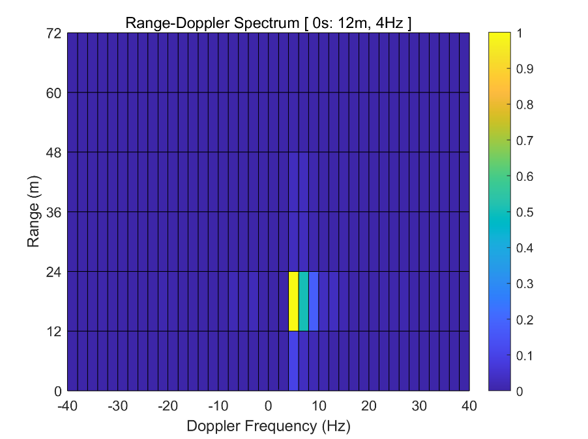
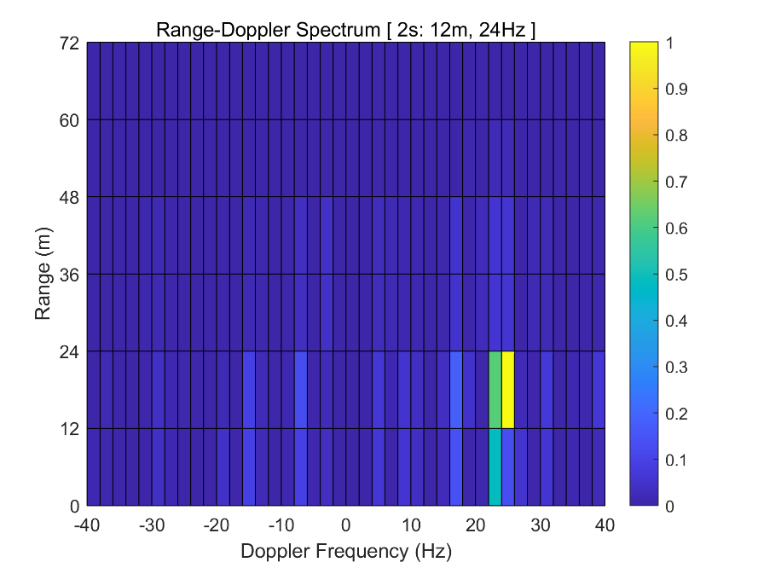
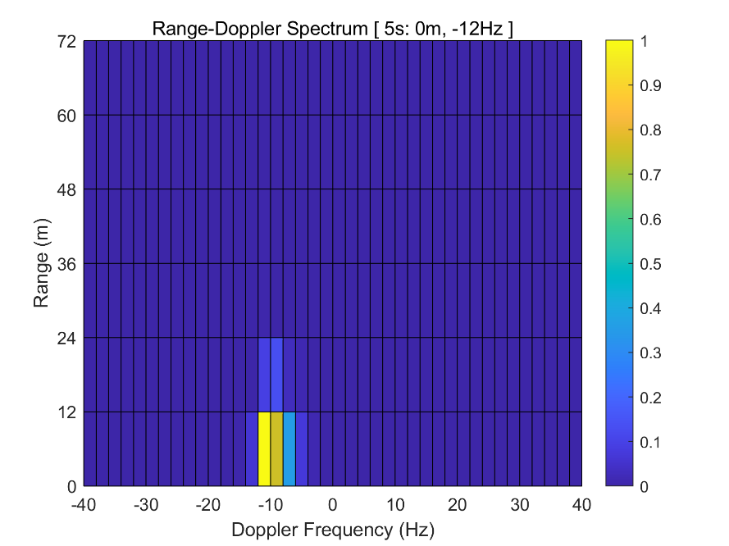
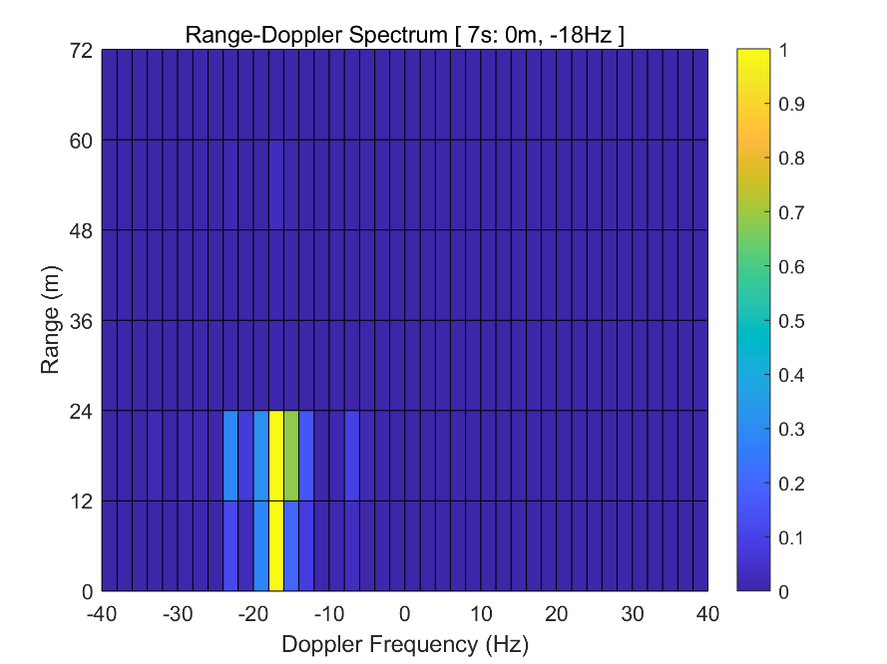
Results & Analysis Task 2
Figure 7 ~ 10: Four Examples of Range – Doppler Frequency Heatmaps
降噪 —— 讲绝对值归一化至 0 ~ 1 区间后取三次幂
Lqy

Slide 16
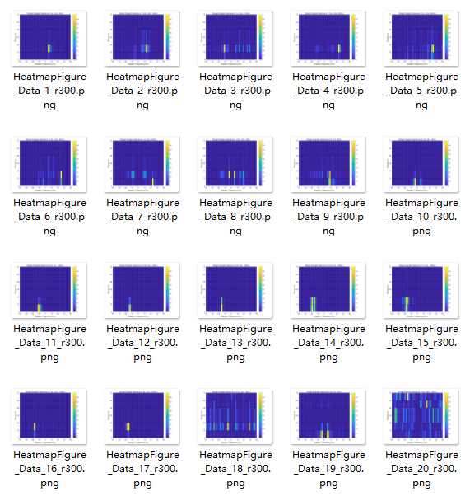
Results & Analysis Task 2
Figure 11: Heatmaps for 20 Data Files

Slide 17
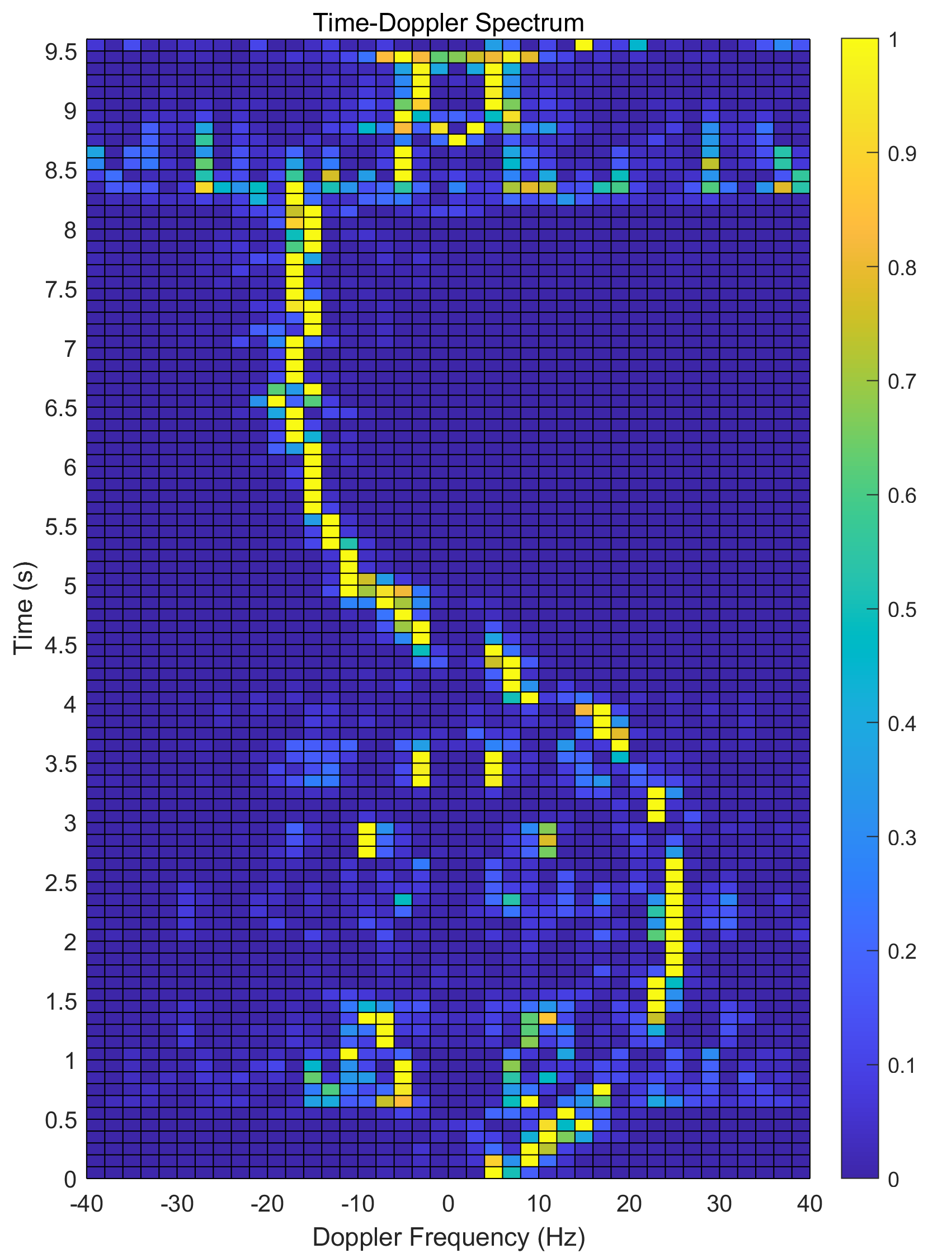
Results & Analysis Task 2
滑动窗口的滑动间隔
调至 0.1s
Figure 12: The Time – Doppler Frequency Spectrum

Slide 18
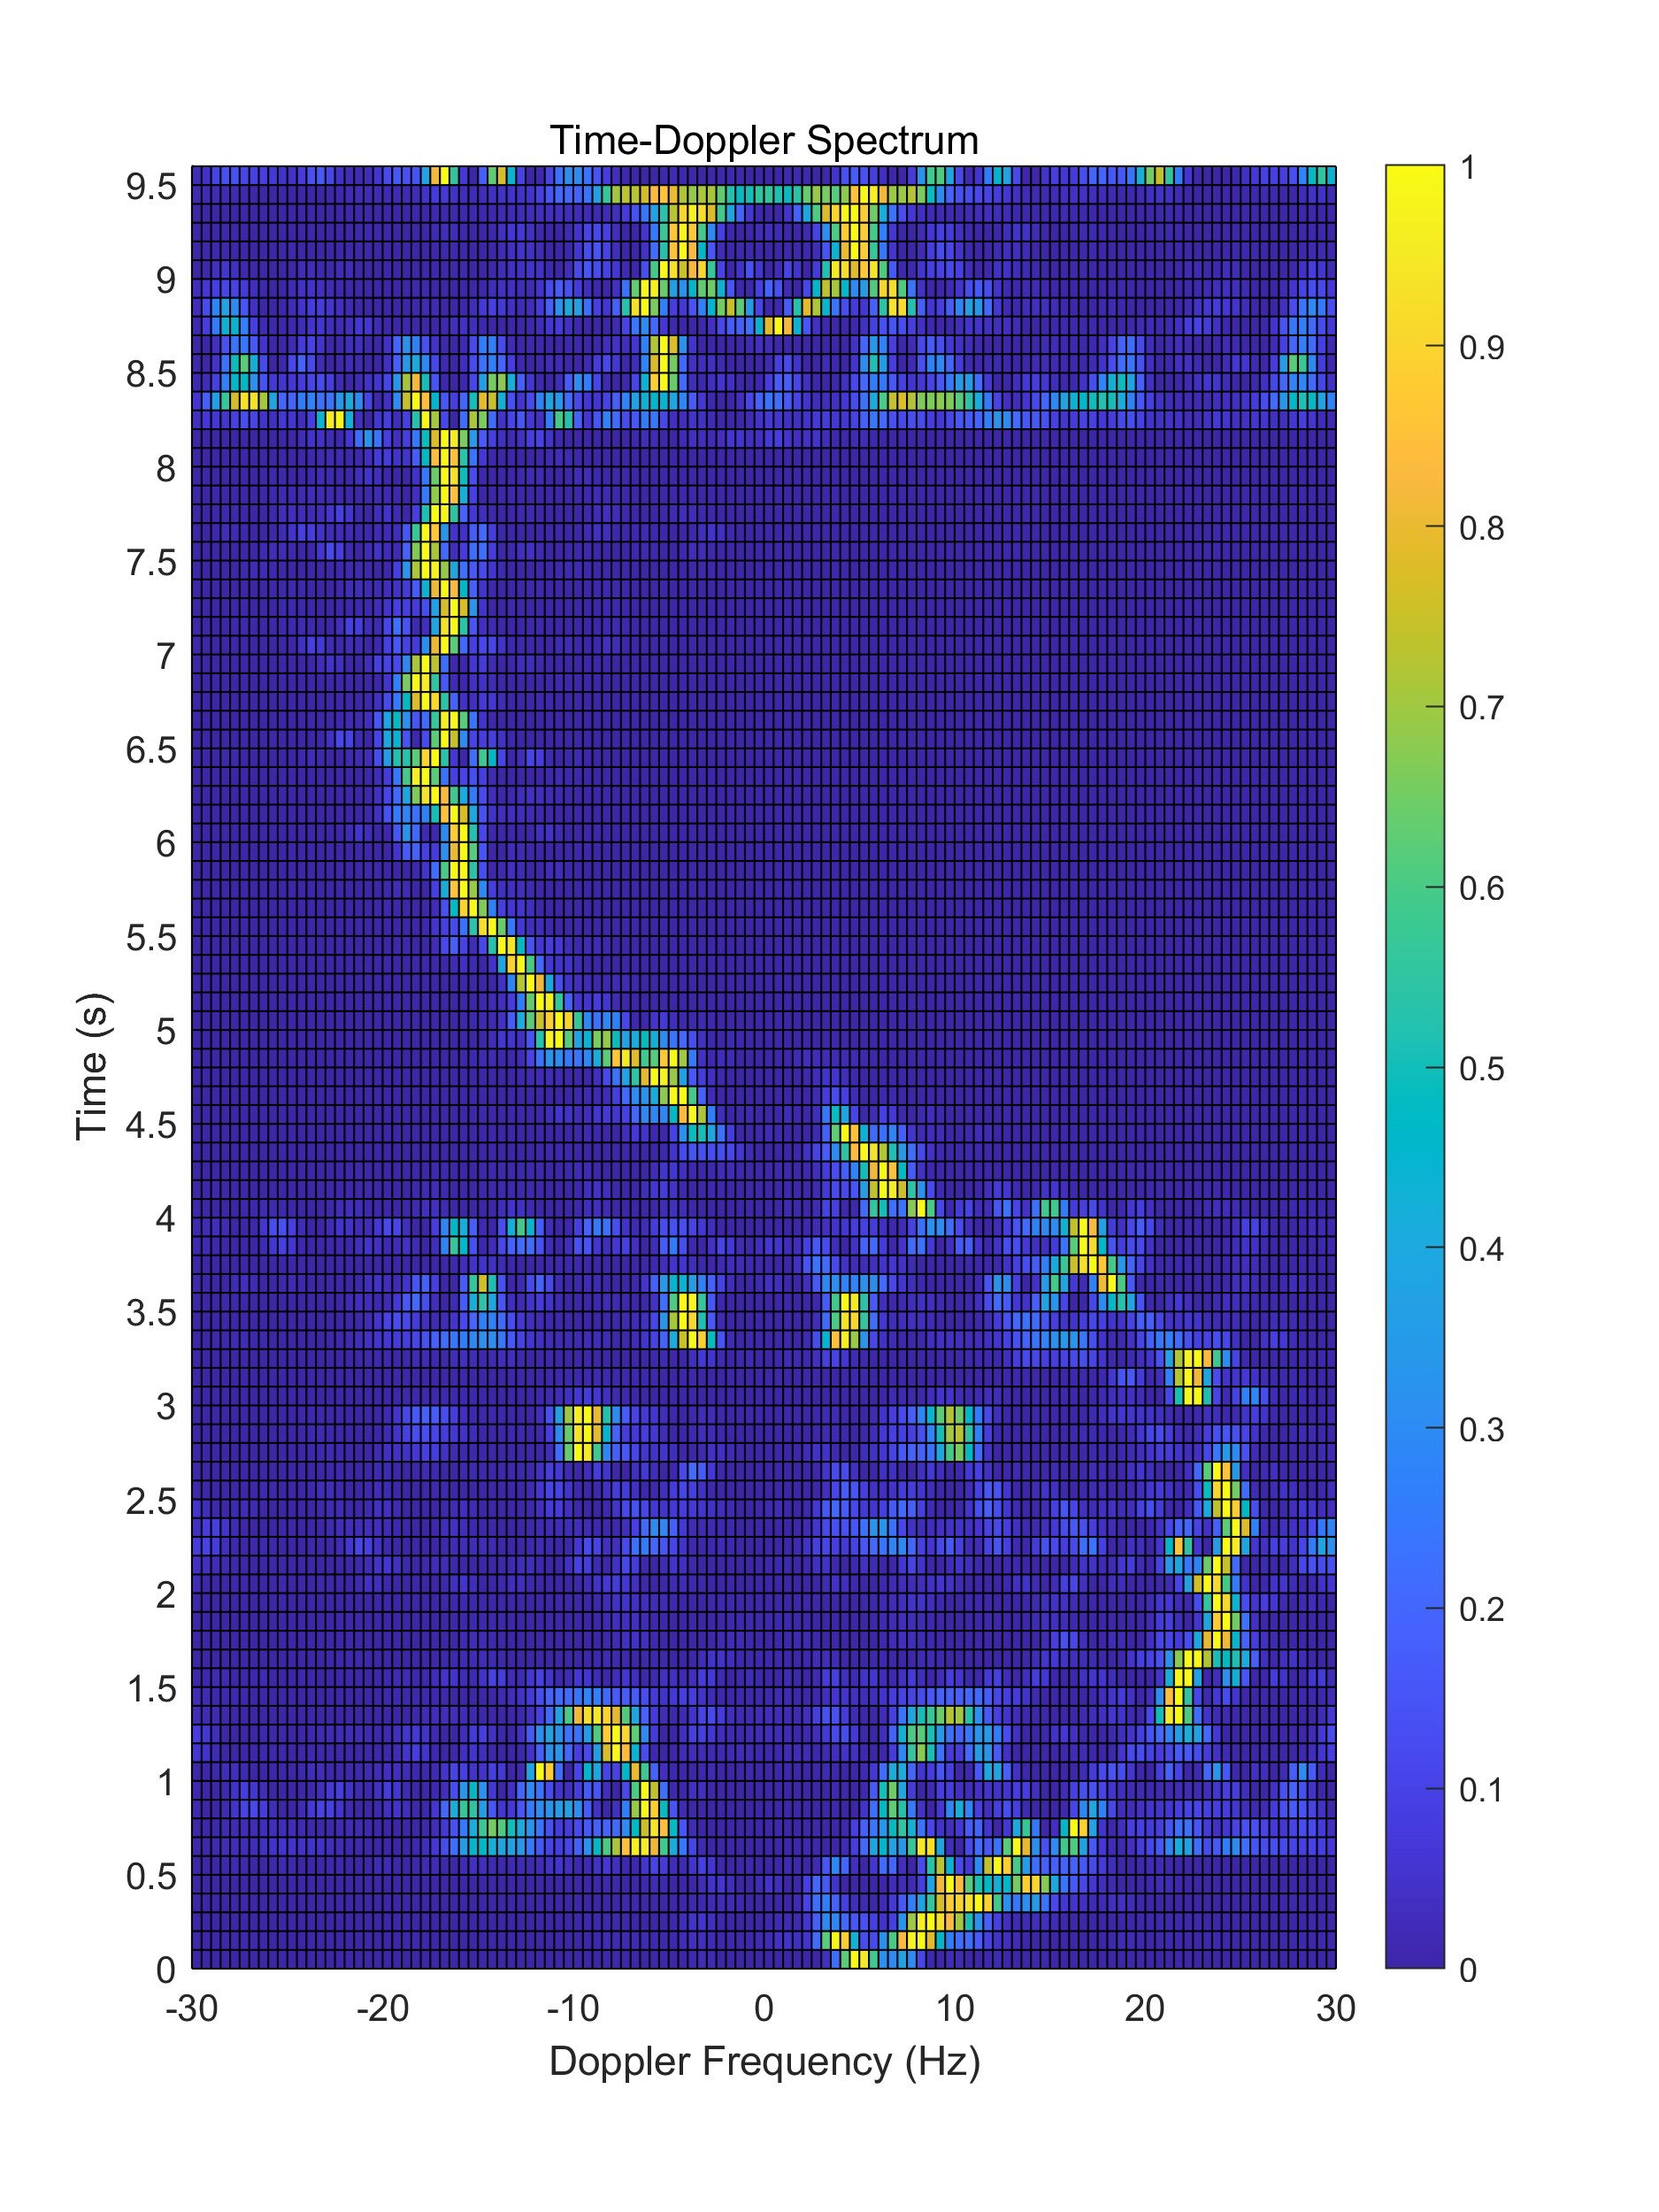
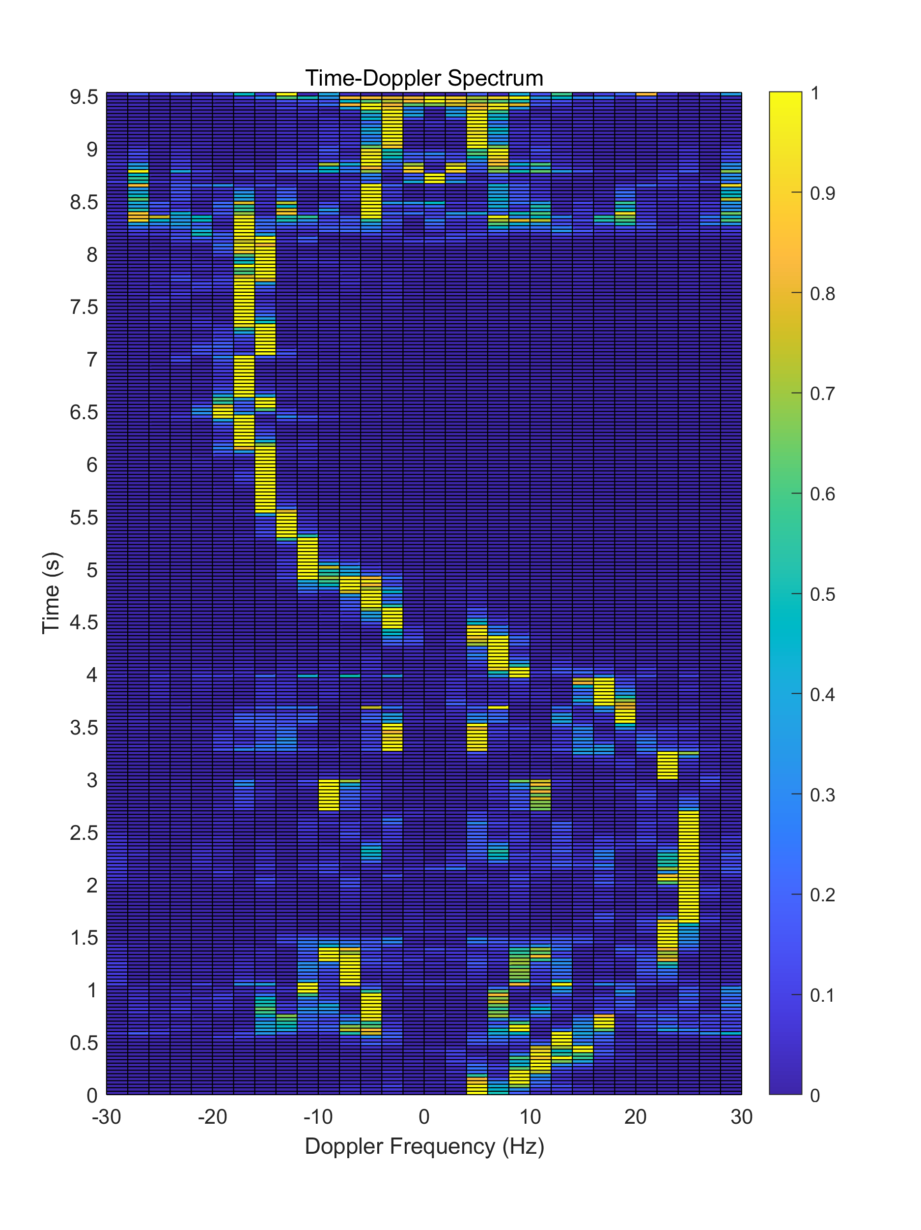
Results & Analysis Task 2
Figure 13 ~ 14: The Time – Doppler Frequency Spectrum (Higher Sampling Rates in Respective Axis)

Slide 19
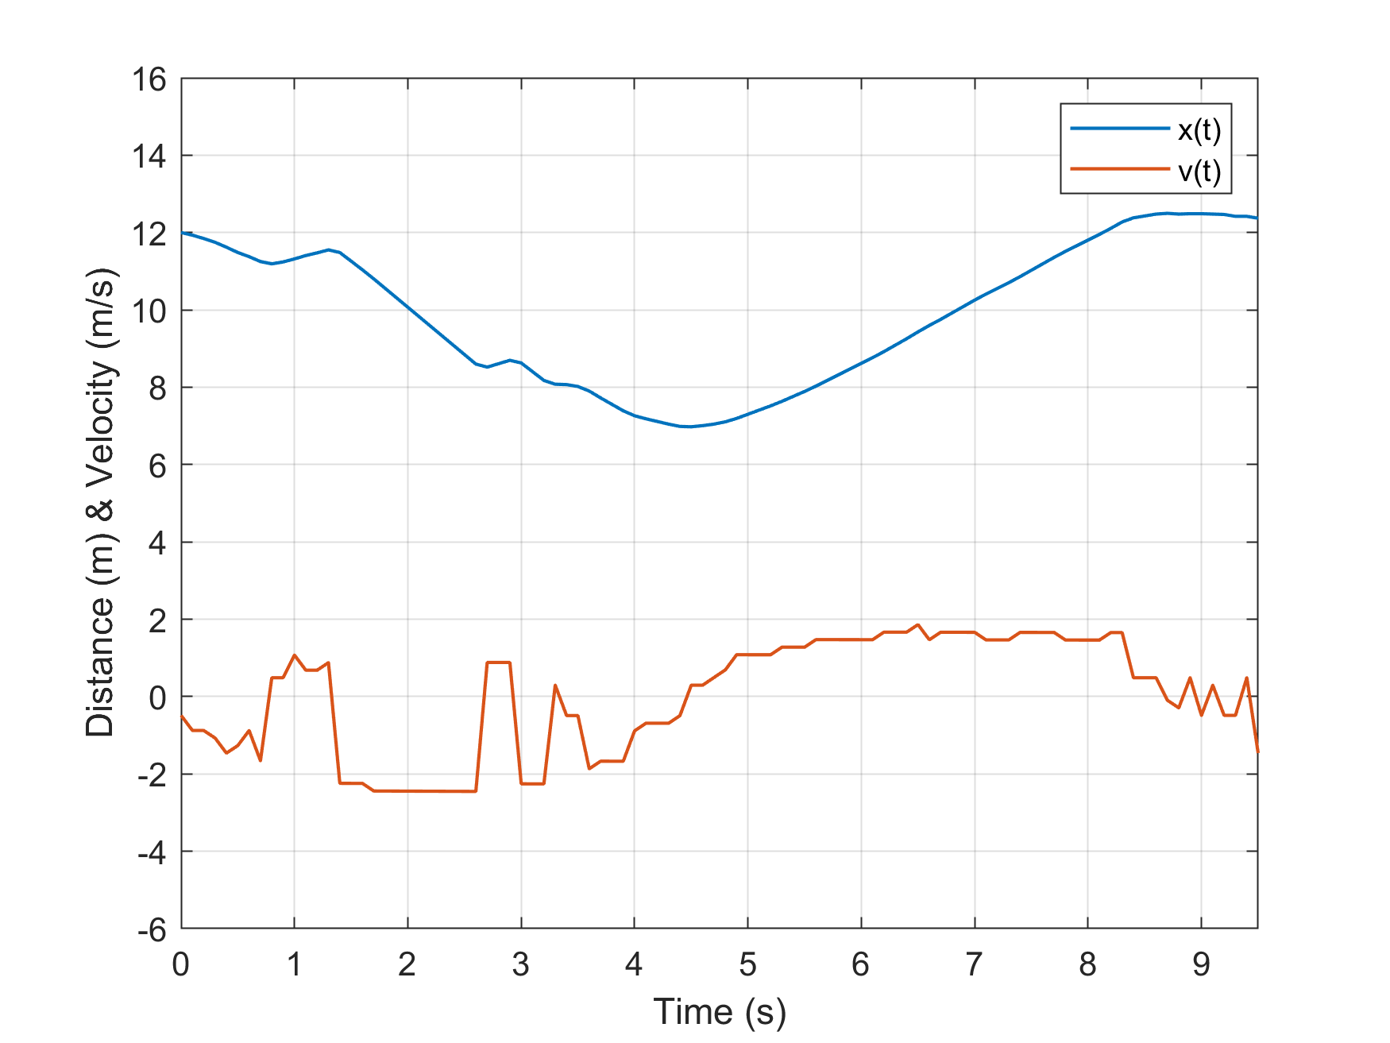
Results & Analysis Task 3
Figure 15: Velocity and Displacement for the Runner

Slide 20
Extension
Radar Applications
Micro Doppler mm-wave Radar

Slide 21

Wp

Slide 22
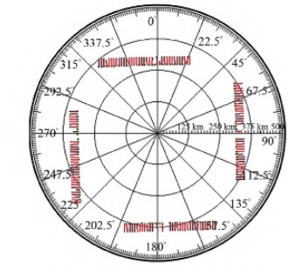
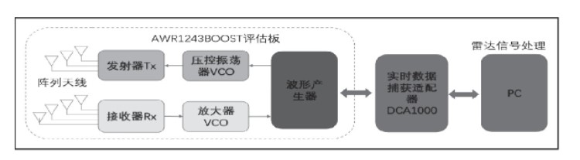
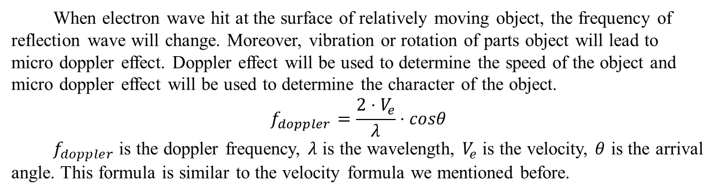
Extension
Figure 16 ~ 17: Extension
Radar can only receive signals from one direction, so when we need to search target of all other directions, we need to build more radars toward different direction.
When electron wave hit at the surface of relatively moving object, the frequency of reflection wave will change. Moreover, vibration or rotation of parts object will lead to micro doppler effect. Doppler effect will be used to determine the speed of the object and micro doppler effect will be used to determine the character of the object.
$$f_{doppler}=\frac{2⋅V_{e}}{λ}⋅cosθ$$
$f_{doppler}$ is the doppler frequency, $λ$ is the wavelength, $V_{e}$ is the velocity, $θ$ is the arrival angle. This formula is similar to the velocity formula we mentioned before.

Slide 23
Review
Experience
Contributors

Slide 24
Review Experience
In this project, we learned about the working principle of passive radar, especially for non-electronic information major students, which greatly enriched our knowledge. In addition, the core of project is the processing of radar signals and understand the meaning of data is the core. The sampling, filtering and frequency conversion are all mentioned previously by teacher in class. The work of project makes us more skilled in this. One of the difficulties in this project is the understanding of the fuzzy function, and its ultimate purpose is to amplify the desired signal. We are also the first time to contact drawing heatmaps, which can allow us to represent our data more vividly in the future.
Fyj

Slide 25
Review Contributors
Introduction – Liu Qianyi;
Objective, Methodology – Wang Zhuoyang;
Task 1 – Feng Yanjie;
Task 2 – Wang Zhuoyang, Wan Peng, Liu Qianyi;
Task 3 – Wang Zhuoyang;
Extension – Wan Peng;
Experience – Liu Qianyi;
Slides – Feng Yanjie, Wang Zhuoyang.

Slide 26
Thanks for Listening.

